Slide 1
UTI Toolkit – Module 3 When to Test a Urine Specimen?

Slide 2
UTI Toolkit – Module 3 Narration by: Anna Eslinger, RN Infection Preventionist Marshfield Medical Center - Eau Claire Content developed in partnership with the Wisconsin Healthcare-Associated Infections in Long-Term Care Coalition
Funding for this project was provided by the Wisconsin Partnership Program at the UW School of Medicine and Public Health

Slide 3
What is a Urinary Tract Infection (UTI)?
There is no gold standard definition of UTI, but several consensus definitions have been suggested and revised over time^{1,2}
These definitions differ slightly, but all require the presence of signs and symptoms localizing to the urinary tract
¹ Loeb et al. ICHE 2001; 22(2): 120-4 ² Stone et.al. ICHE 2012; 33(10): 965-77

Slide 4
Signs and Symptoms Specific for UTI
Dysuria
New onset
Frequency
Urgency
Incontinence
Flank pain or tenderness
Suprapubic pain
Gross hematuria
Focal tenderness or swelling of testis, epididymis or prostate
Recent catheter trauma, obstruction, or purulent drainage around the catheter
Nace, et.al. JAMDA 2014; 15(2): 133-39

Slide 5
What about Non-Communicative Residents?
Residents frequently have non-specific geriatric symptoms and are unable to tell us what is bothering them
Non-specific symptoms include:
Functional decline
Changes in mental status
Altered behaviors
Falls
Unfortunately, these symptoms are non-specific and often triggered by other (for example, non-infectious) causes
Nace, et.al. JAMDA 2014; 15(2): 133-39

Slide 6
Are Changes in Mental Status, Behavior, or a Fall Symptoms of a UTI?
Sometimes, but most commonly NOT
UTI is less likely without specific urinary symptoms
Non-specific geriatric symptoms, such as change in mental status, fatigue, or a fall may be due to a variety of non-infectious causes including:
Medications (e.g., opiates) | Sleep deprivation | Low oxygen (CHF, COPD)
Dehydration | Hypoglycemia | High carbon dioxide (COPD)
Pain | Electrolyte imbalance | Stroke
Constipation | Depression | Seizure

Slide 7
In other words…
Don’t think testing urine first in a resident with a change in condition and no localizing urinary tract signs and symptoms

Slide 8
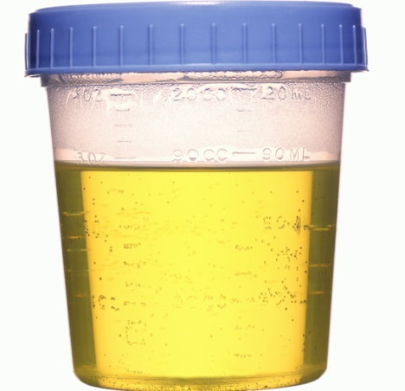
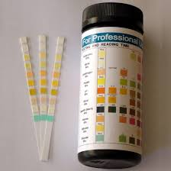
Non-specific Geriatric Symptoms May Accompany a UTI but…
Without another localizing urinary symptom or fever or leukocytosis and no other identified source of infection,
these non-specific symptoms are unlikely a sign of UTI
AND
A urine specimen should NOT be sent
Drinka P. JAMDA 2009; 10(8): 516-19

Slide 9
What about Non-Communicative Residents?
“A patient with advanced dementia may be unable to report urinary symptoms. In this situation, it is reasonable to obtain a urine culture if there are signs of systemic infection such as fever (increase in temperature of equal to or greater than 2°F [1.1°C] from baseline) leukocytosis, or a left shift or chills in the absence of additional symptoms (e.g., new cough) to suggest an alternative source of infection.” *
*AMDA Choosing Wisely Campaign (See Item 3, https://paltc.org/choosing-wisely)

Slide 10
Change in the Character of the Urine ≠ UTI
Dark, concentrated and/or strong smelling urine can be caused by several factors, including dehydration, diet, medication, or the presence of specific bacteria
Changes in the character of the urine WITHOUT specific urinary symptoms do not indicate the presence of UTI
Without specific urinary tract signs and symptoms, DO NOT TEST

Slide 11
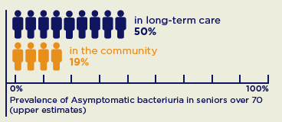
Bacteria in the Urine ≠ UTI
The skin surface is not sterile…
The mouth is not sterile…
The colon is not sterile…
And in many nursing home residents the bladder is not sterile
Up to 50% of LTC residents have bacteria in their urine without any signs of infection*
* Massachusetts Coalition for Patient Safety

Slide 12
When Symptoms are Absent:
“Positive” urine dip is meaningless
“Positive” urinalysis is meaningless
“Positive” urine culture is just Asymptomatic Bacteriuria
Regardless of symptoms:
Poor urine collection technique causes false-positive urinalysis
See Module 2 for how to collect urine properly

Slide 13
Positive Urine Culture Without Localizing Urinary Tract Symptoms
DO NOT TREAT

